Slide 1
8051 Microcontroller

Slide 2
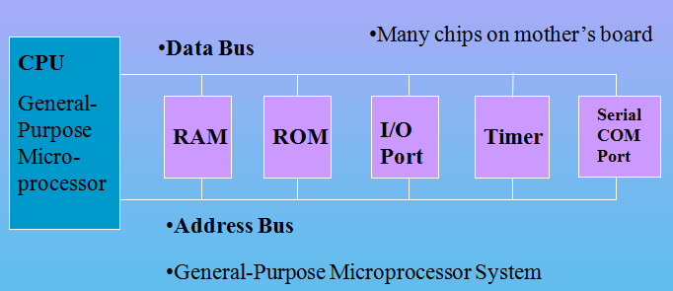
Microprocessor Based System
CPU
External RAM, ROM, I/O
(No internal RAM, ROM, I/O ports in the CPU)

Slide 3
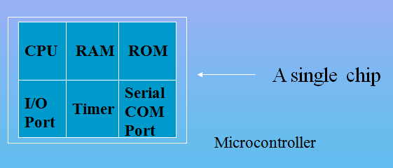
Microcontroller
A smaller computer on a CHIP
On-chip RAM, ROM, I/O Ports, Timer, Serial Controller…
Example: Motorola’s 6811, Intel’s 8051, Atmel 32, Atmel 89S51

Slide 4
Microprocessor vs. Microcontroller
Microprocessor
CPU is stand-alone, RAM, ROM, I/O, timer are separate
Designer can decide on the amount of ROM, RAM and I/O ports.
Versatility
General-purpose
Microcontroller
CPU, RAM, ROM, I/O and timer are all on a single chip
Fixed amount of on-chip ROM, RAM, I/O ports
Single-purpose
Special Purpose.

Slide 5
μC based Embedded Systems
Special purpose computer system usually completely inside the device it controls
Has specific requirements and performs pre-defined tasks
Cost reduction compared to general purpose processor
Different design criteria
Performance
Reliability
Availability
Safety

Slide 6
8051 CPU Operation
Features
Pin Diagram
Block Diagram

Slide 7
Features of 8051
8 bit Processor
4KB Internal ROM
128 Bytes Internal RAM
Four 8 BIT I/O PORTS (32 I/O LINES)
Two 16 Bit Timers/Counters
On Chip Full Duplex UART for Serial Communication
5 Vector Interrupts ( 2 External, 3 Internal - Timer0,Timer1,Serial)
On Chip Clock Oscillator
16 bit Address bus
64k External Code Memory
64k External Data Memory
16-bit program counter to access external Code Memory and
16 bit Data Pointer to access external Data Memory
128 user defined flags
32 General Purpose Registers each of 8 bits

Slide 8
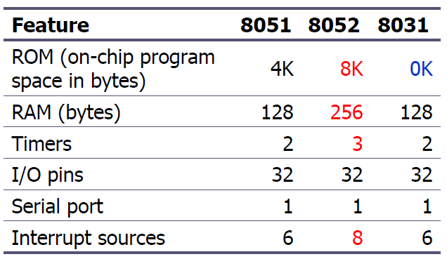
8051 Family
The 8051 is a subset of the 8052
The 8031 is a ROM-less 8051
Add external ROM to it
You lose two ports, and leave only 2 ports for I/O operations

Slide 9
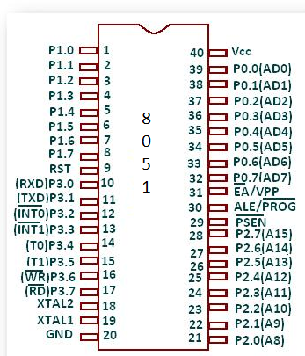
Pin Diagram

Slide 10
Pin Description of the 8051
8051 family members (e.g., 8751, 89C51, 89C52, DS89C4x0)
Have 40 pins dedicated for various functions such as I/O, RD, WR, address, data, and interrupts.
Come in different packages, such as
DIP(dual in-line package),
QFP(quad flat package), and
LLC(leadless chip carrier)
Some companies provide a 20-pin version of the 8051 with a reduced number of I/O ports for less demanding applications

Slide 11
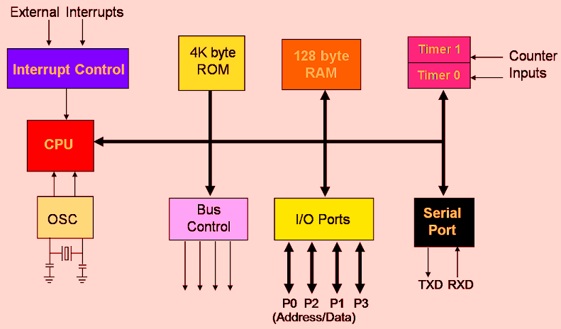
Block Diagram of 8051

Slide 12
Separate read instructions for external data and code memory.
Notes:
12

Slide 13
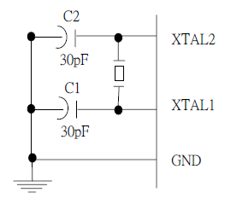
XTAL1 and XTAL2
The 8051 has an on-chip oscillator but requires an external crystal to run it
A quartz crystal oscillator is connected to inputs XTAL1 (pin19) and XTAL2 (pin18)
The quartz crystal oscillator also needs two capacitors of 30 pF value
The original 8051 operates at 12 MHZ

Slide 14
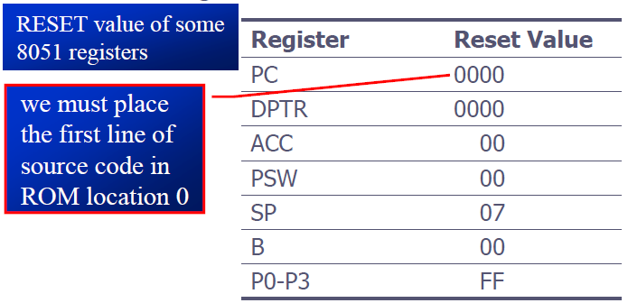
RST
RESET pin is an input and is active high (normally low)
Upon applying a high pulse to this pin, the microcontroller will reset and terminate all activities
This is often referred to as a power-on reset
Activating a power-on reset will cause all values in the registers to be lost

Slide 15
EA’
EA’, “external access’’, is an input pin and must be connected to Vcc or GND
The 8051 family members all come with on-chip ROM to store programs and also have an external code and data memory.
Normally EA pin is connected to Vcc (Internal Access)
EA pin must be connected to GND to indicate that the code or data is stored externally.

Slide 16
PSEN’ and ALE
PSEN, “program store enable’’, is an output pin
This pin is connected to the OE pin of the external memory.
For External Code Memory, PSEN’ = 0
For External Data Memory, PSEN’ = 1
ALE pin is used for demultiplexing the address and data.

Slide 17
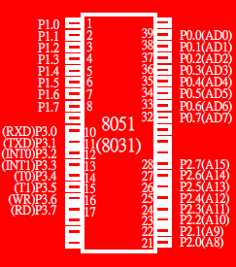
I/O Port Pins
The four 8-bit I/O ports P0, P1, P2 and P3 each uses 8 pins.
All the ports upon RESET are configured as output, ready to be used as input ports by the external device.

Slide 18
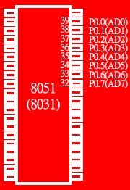
Port 0
Port 0 is also designated as AD0-AD7.
When connecting an 8051 to an external memory, port 0 provides both address and data.
The 8051 multiplexes address and data through port 0 to save pins.
ALE indicates if P0 has address or data.
When ALE=0, it provides data D0-D7
When ALE=1, it has address A0-A7

Slide 19
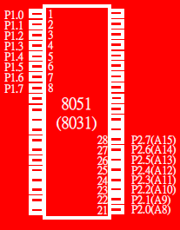
Port 1 and Port 2
In 8051-based systems with no external memory connection:
Both P1 and P2 are used as simple I/O.
In 8051-based systems with external memory connections:
Port 2 must be used along with P0 to provide the 16-bit address for the external memory.
P0 provides the lower 8 bits via A0 – A7.
P2 is used for the upper 8 bits of the 16-bit address, designated as A8 – A15, and it cannot be used for I/O.

Slide 20
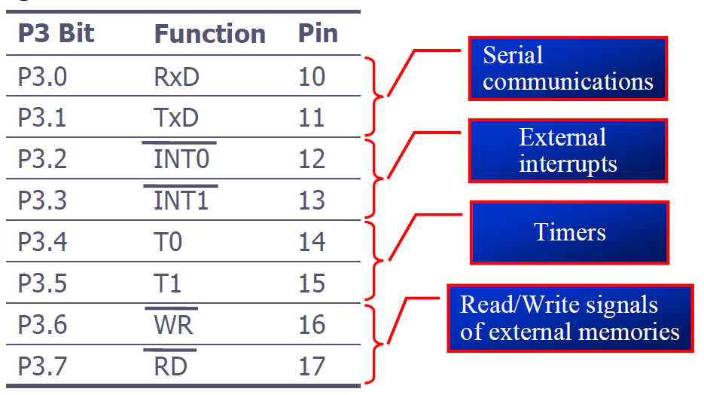
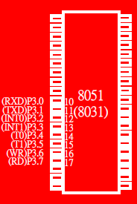
Port 3
Port 3 can be used as input or output.
Port 3 has the additional function of providing some extremely important signals

Slide 21
Pin Description Summary
PIN | TYPE | NAME AND FUNCTION
Vss | I | Ground: 0 V reference.
Vcc | I | Power Supply: This is the power supply voltage for normal, idle, and power-down operation.
P0.0 - P0.7 | I/O | Port 0: Port 0 is an open-drain, bi-directional I/O port. Port 0 is also the multiplexed low-order address and data bus during accesses to external program and data memory.
P1.0 - P1.7 | I/O | Port 1: Port I is an 8-bit bi-directional I/O port.
P2.0 - P2.7 | I/O | Port 2: Port 2 is an 8-bit bidirectional I/O. Port 2 emits the high order address byte during fetches from external program memory and during accesses to external data memory that use 16 bit addresses.
P3.0 - P3.7 | I/O | Port 3: Port 3 is an 8 bit bidirectional I/O port. Port 3 also serves special features as explained.

Slide 22
Pin Description Summary
PIN | TYPE | NAME AND FUNCTION
RST | I | Reset: A high on this pin for two machine cycles while the oscillator is running, resets the device.
ALE | O | Address Latch Enable: Output pulse for latching the low byte of the address during an access to external memory.
PSEN* | O | Program Store Enable: The read strobe to external program memory. When executing code from the external program memory, PSEN* is activated twice each machine cycle, except that two PSEN* activations are skipped during each access to external data memory.
EA*/VPP | I | External Access Enable/Programming Supply Voltage: EA* must be externally held low to enable the device to fetch code from external program memory locations. If EA* Is held high, the device executes from internal program memory. This pin also receives the programming supply voltage Vpp during Flash programming. (applies for 89c5x MCU's)

Slide 23
General Block Diagram of 8051
4K
ROM
Interrupt
Control
128 B
RAM
Timer 0
Timer 1
CPU
Bus
Control
4 I/O Ports
Serial
Port
OSC
TXD
RXD
P0
P1
P2
P3

Slide 24
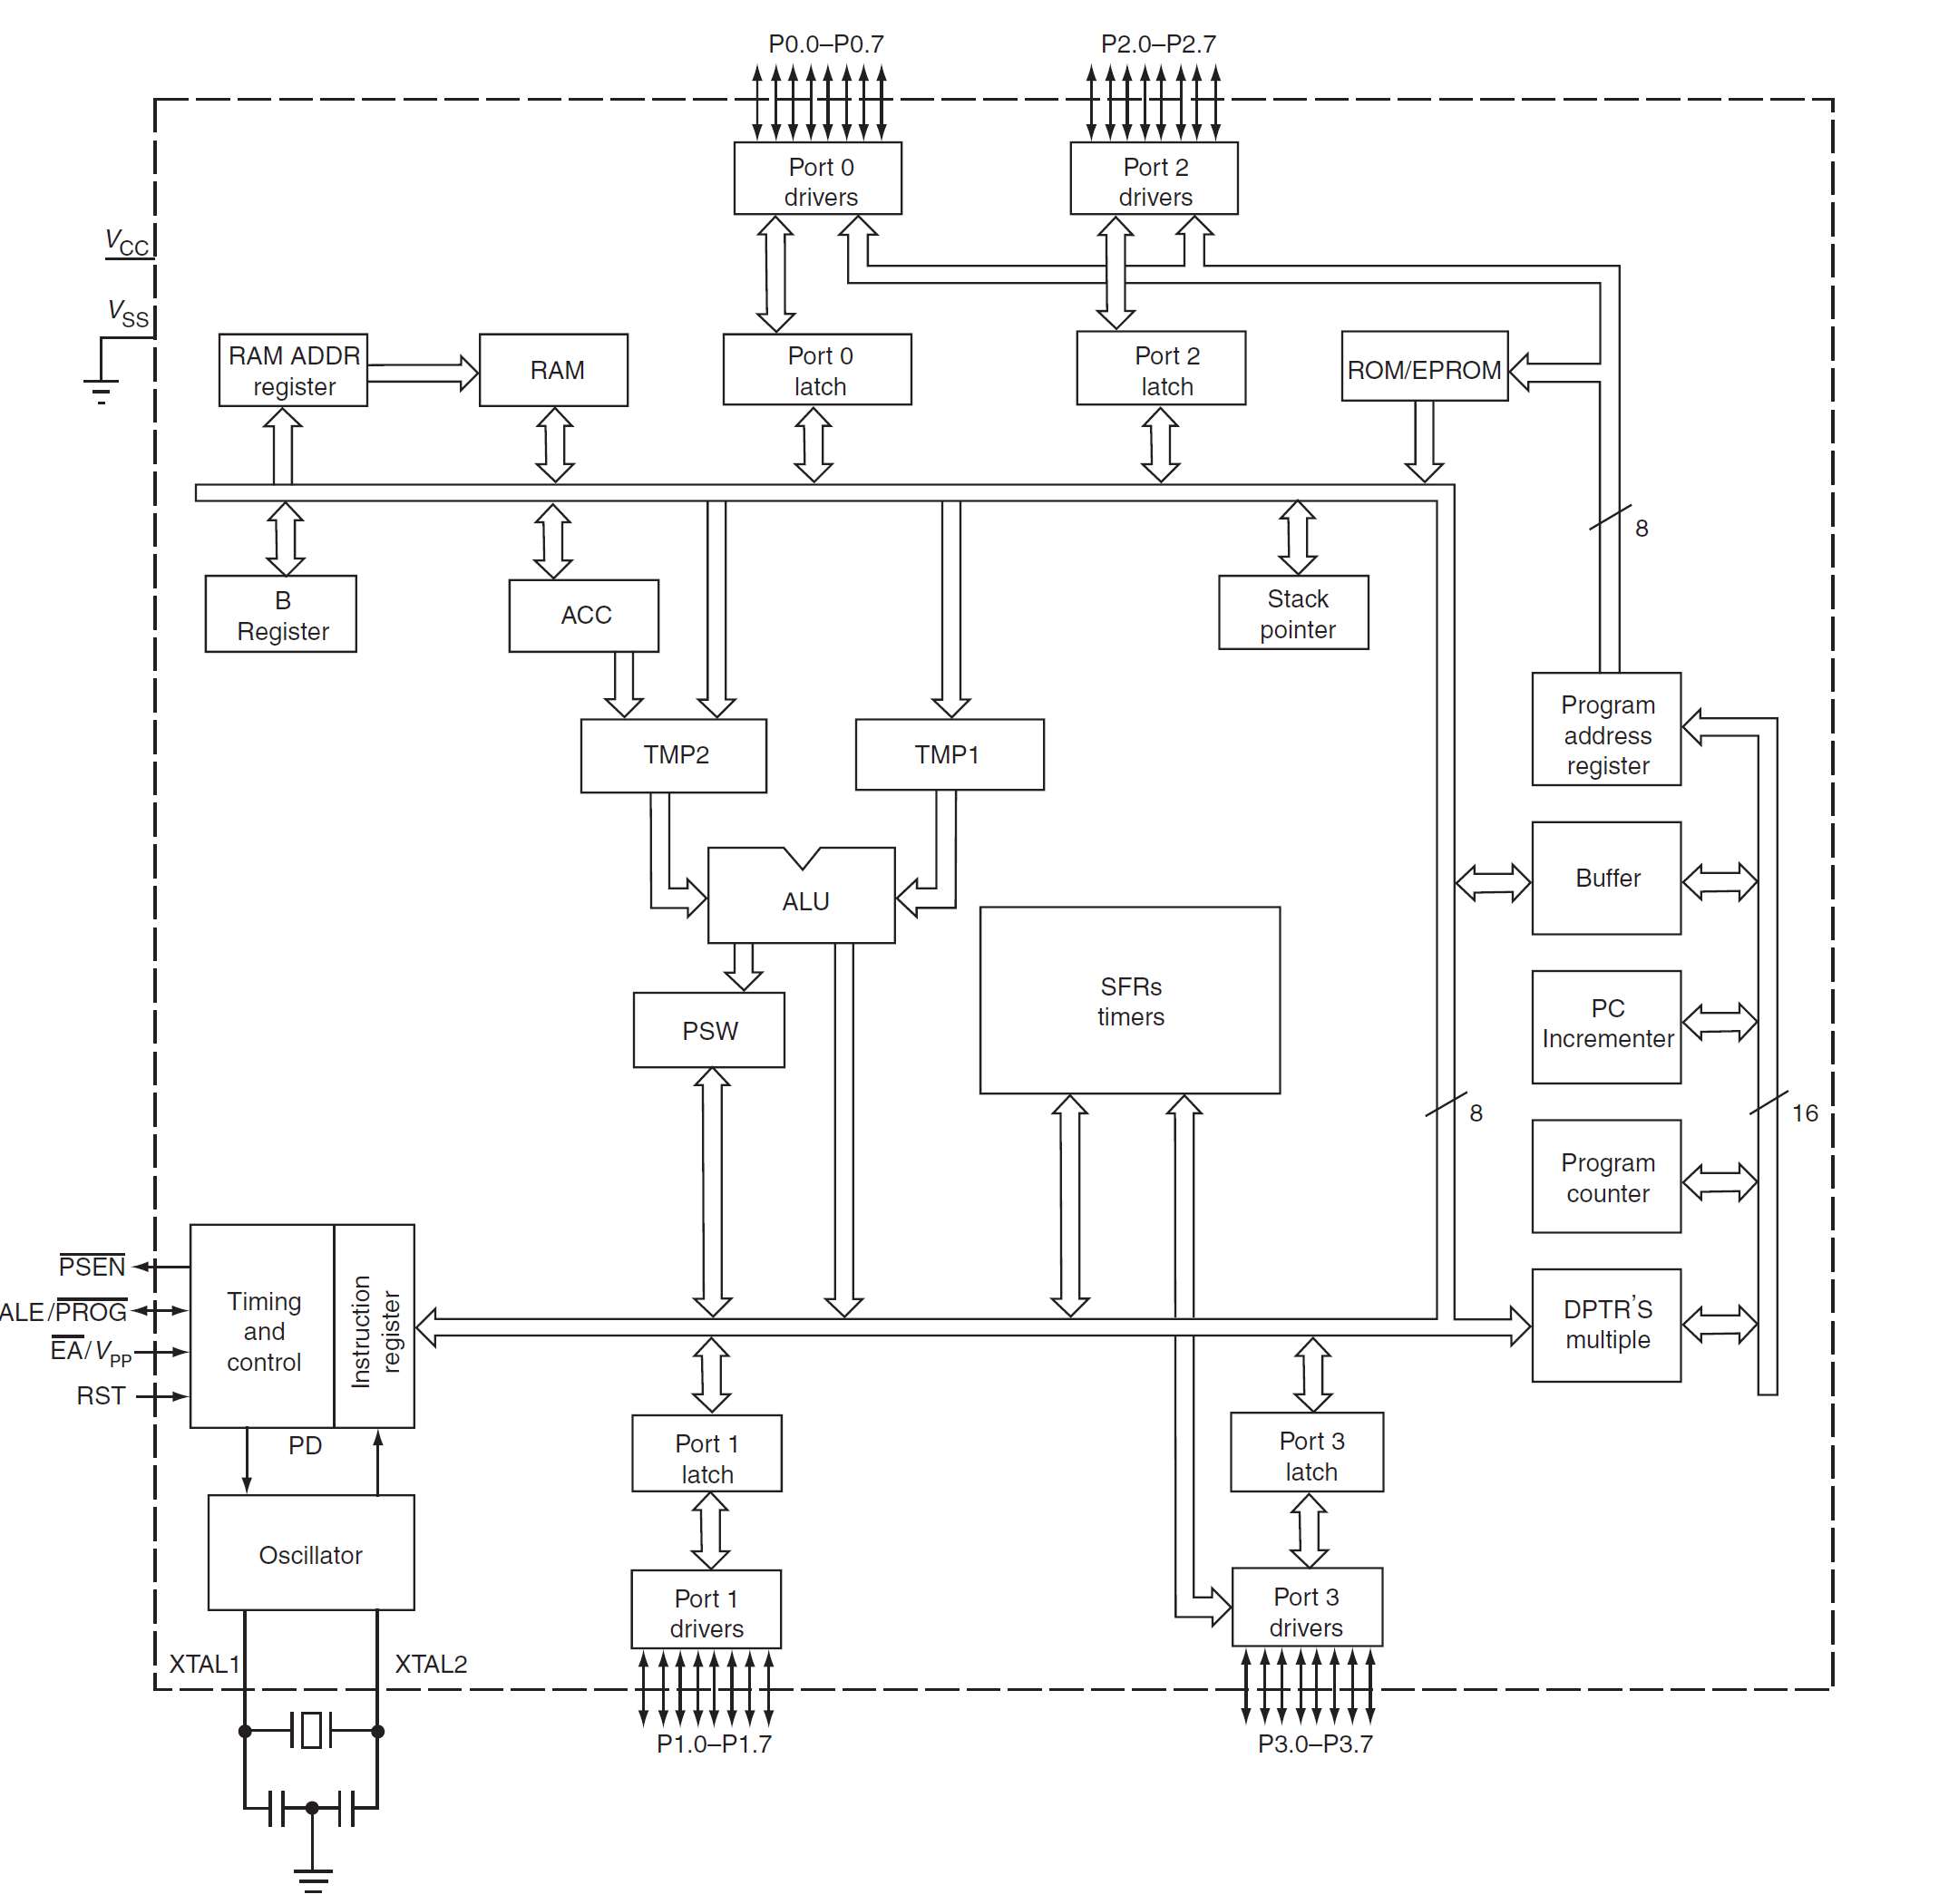
Detailed Block Diagram

Slide 25
8051 Memory Space

Slide 26
Internal RAM Structure
Direct
Addressing
Only
SFR [ Special Function Registers]
Direct &
Indirect
Addressing
128 Byte Internal RAM

Slide 27
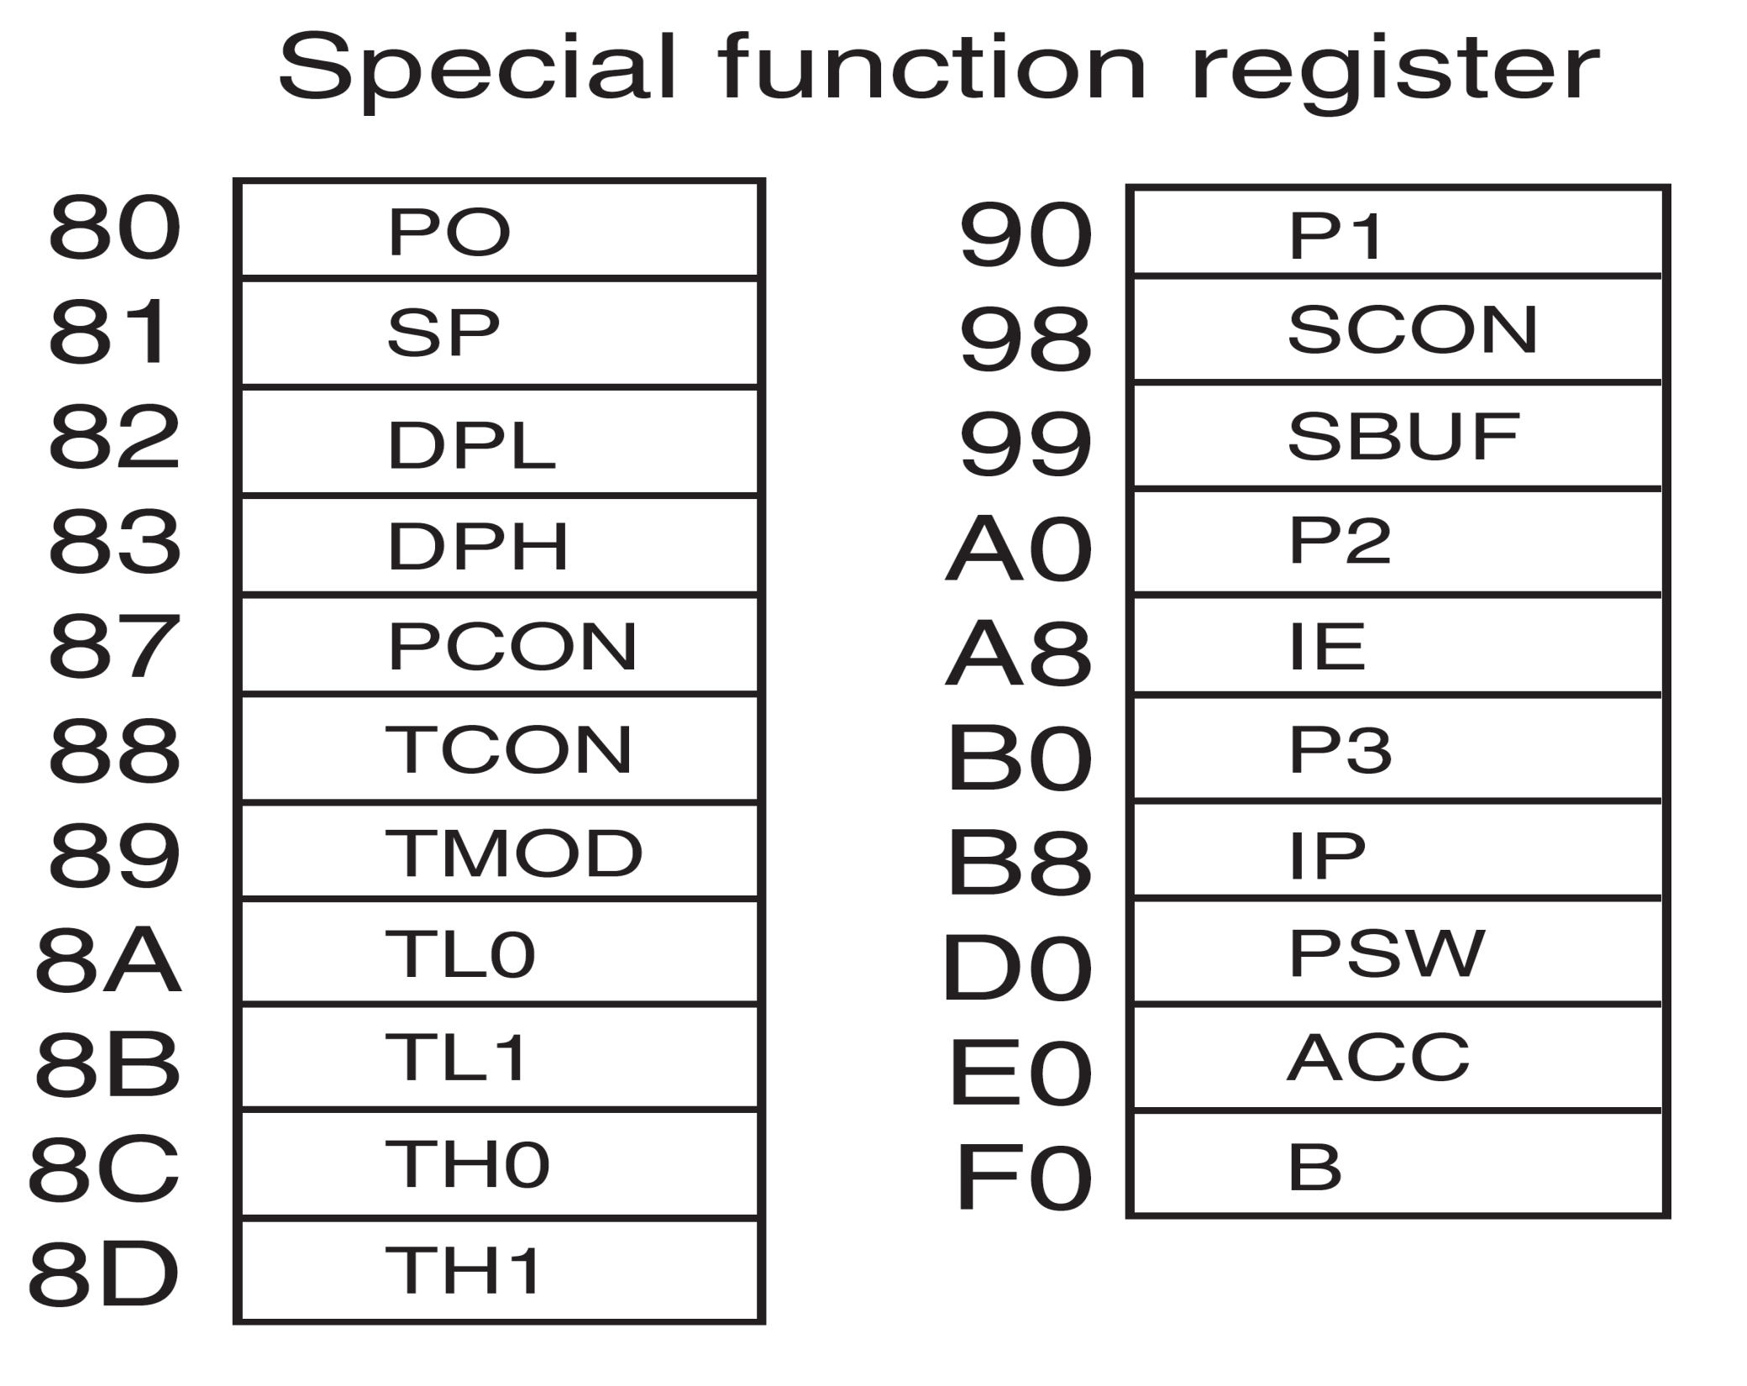












Slide 28
Program Status Word [PSW]
C AC F0 RS1 RS0 OV F1 P
Carry
Parity
Auxiliary Carry
User Flag 1
User Flag 0
Register Bank Select
Overflow

Slide 29
128 Byte RAM
There are 128 bytes of RAM in the 8051.
Assigned addresses 00 to 7FH
The 128 bytes are divided into 3 different groups as follows:
A total of 32 bytes from locations 00 to 1F hex are set aside for register banks and the stack.
A total of 16 bytes from locations 20H to 2FH are set aside for bit-addressable read/write memory.
A total of 80 bytes from locations 30H to 7FH are used for read and write storage, called scratch pad.
General Purpose
Area
BIT Addressable
Area
Reg Bank 3
Reg Bank 2
Reg Bank 1
Reg Bank 0

Slide 30
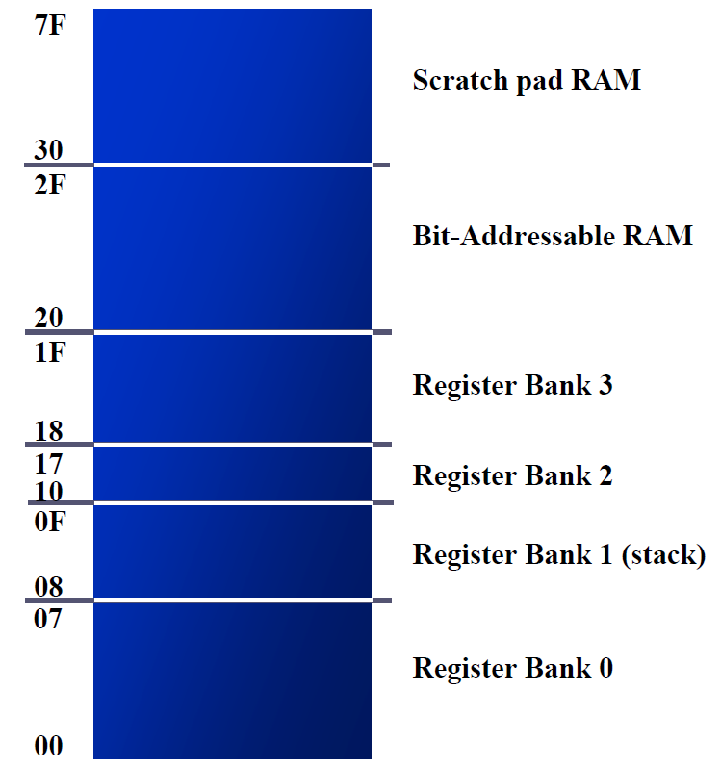
8051 RAM with addresses

Slide 31
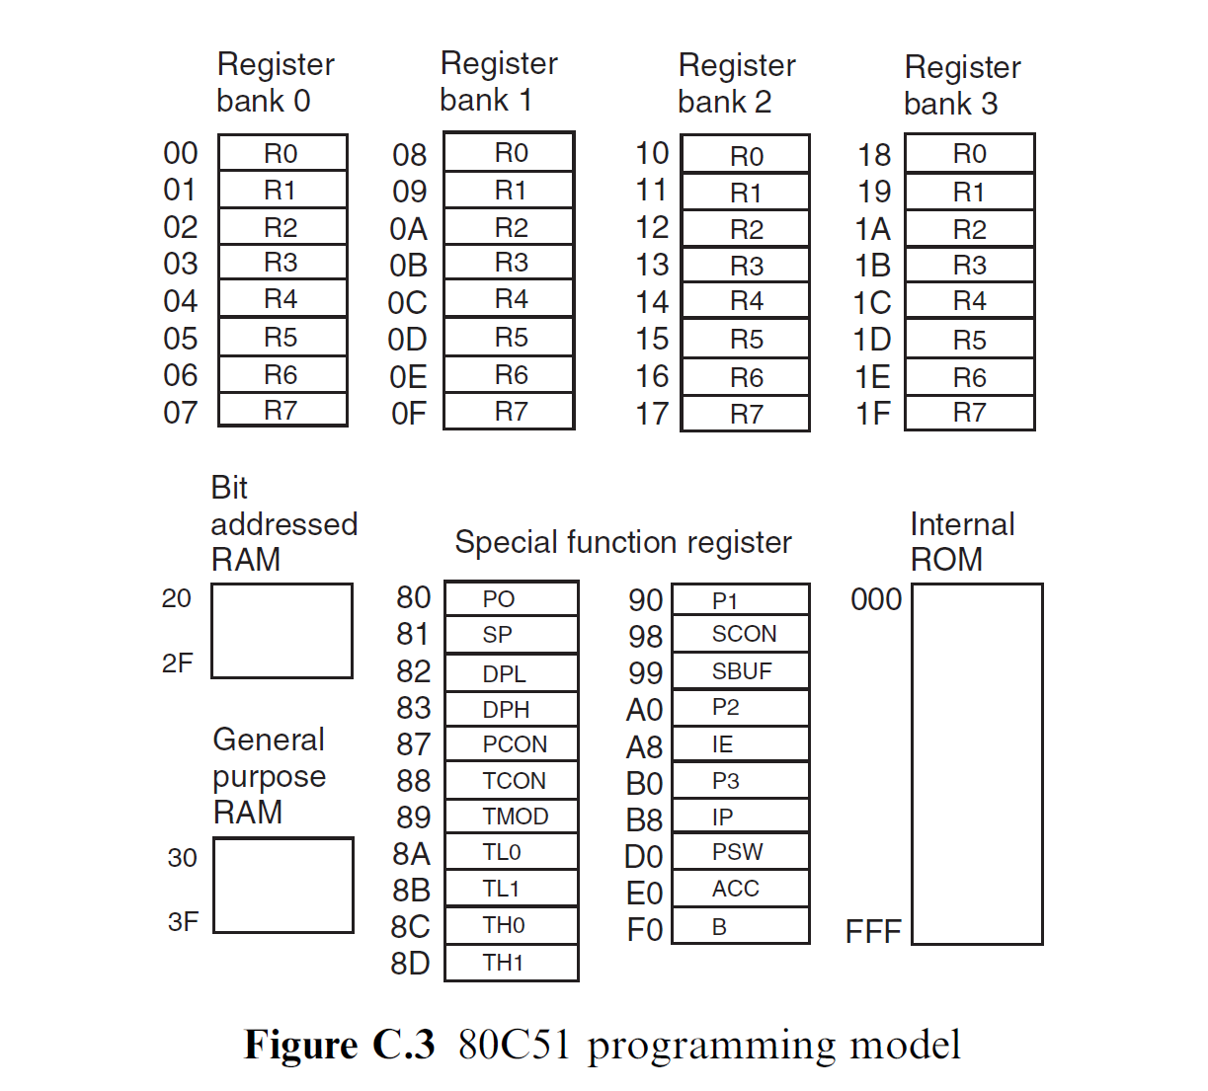
8051 Programming Model

Slide 32
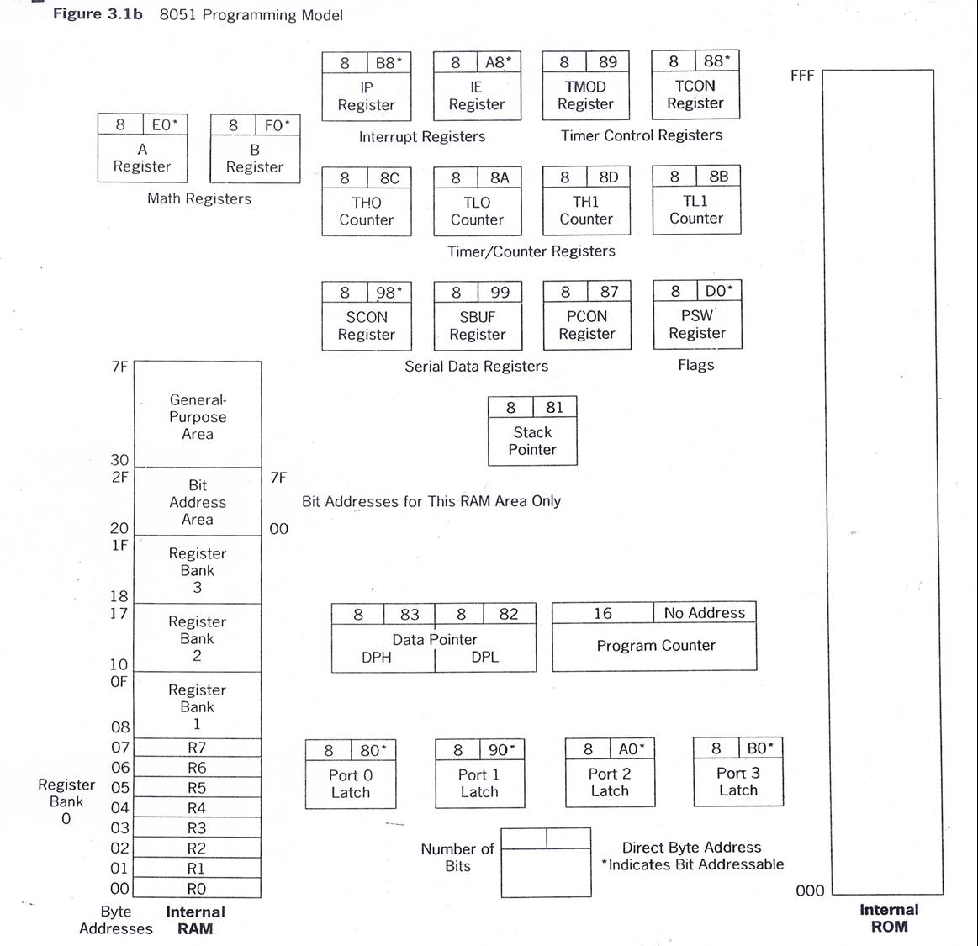

Slide 33
8051 Stack
The stack is a section of RAM used by the CPU to store information temporarily.
This information could be data or an address
The register used to access the stack is called the SP (stack pointer) register
The stack pointer in the 8051 is only 8 bit wide, which means that it can take value of 00 to FFH
When the 8051 is powered up, the SP register contains value 07
RAM location 08 is the first location begin used for the stack by the 8051

Slide 34
8051 Stack
The storing of a CPU register in the stack is called a PUSH
SP is pointing to the last used location of the stack
As we push data onto the stack, the SP is incremented by one
Loading the contents of the stack back into a CPU register is called a POP
With every pop, the top byte of the stack is copied to the register specified by the instruction and the stack pointer is decremented once

Slide 35
8051 Software Overview
Addressing Modes
Instruction Set
Programming

Slide 36
8051 Addressing Modes
The CPU can access data in various ways, which are called addressing modes
Immediate
Register
Direct
Register indirect
External Direct

Slide 37
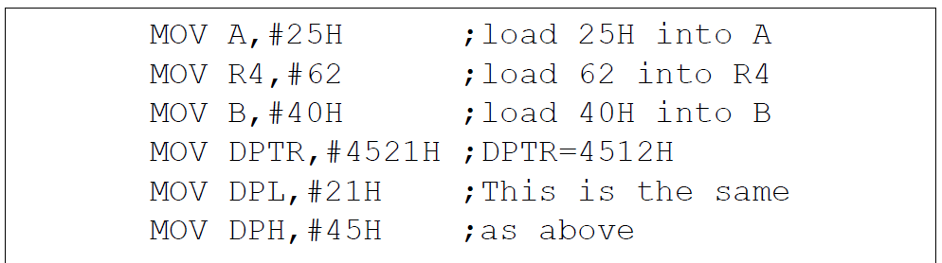
Immediate Addressing Mode
The source operand is a constant.
The immediate data must be preceded by the pound sign, “#”
Can load information into any registers, including 16-bit DPTR register
DPTR can also be accessed as two 8-bit registers, the high byte DPH and low byte DPL

Slide 38
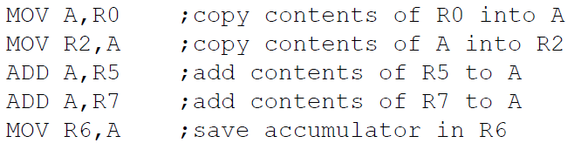

Register Addressing Mode
Use registers to hold the data to be manipulated.
The source and destination registers must match in size.
MOV DPTR,A will give an error
The movement of data between Rn registers is not allowed
MOV R4,R7 is invalid

Slide 39

Direct Addressing Mode
It is most often used the direct addressing mode to access RAM locations 30 – 7FH.
The entire 128 bytes of RAM can be accessed.
Contrast this with immediate addressing mode, there is no “#” sign in the operand.

Slide 40
SFR Registers & their Addresses
MOV 0E0H,#55H ;is the same as
MOV A,#55H ;which means load 55H into A (A=55H)
MOV 0F0H,#25H ;is the same as
MOV B,#25H ;which means load 25H into B (B=25H)
MOV 0E0H,R2 ;is the same as
MOV A,R2 ;which means copy R2 into A
MOV 0F0H,R0 ;is the same as
MOV B,R0 ;which means copy R0 into B

Slide 41
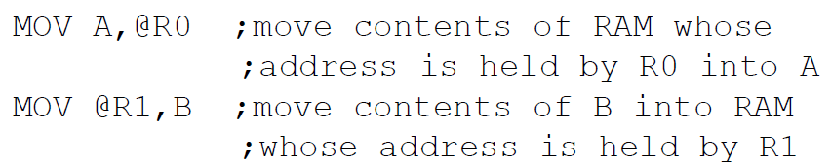
Register Indirect Addressing Mode
A register is used as a pointer to the data.
Only register R0 and R1 are used for this purpose.
R2 – R7 cannot be used to hold the address of an operand located in RAM.
When R0 and R1 hold the addresses of RAM locations, they must be preceded by the “@” sign.

Slide 42
External Direct
External Memory is accessed.
There are only two commands that use External Direct addressing mode:
MOVX A, @DPTR MOVX @DPTR, A
DPTR must first be loaded with the address of external memory.

Slide 43
8051 Instruction Set
8051 instructions have 8-bit opcode
There are 256 possible instructions of which 255 are implemented

Slide 44
MOV Instruction
MOV destination, source ; copy source to destination.
MOV A,#55H ;load value 55H into reg. A MOV R0,A ;copy contents of A into R0 ;(now A=R0=55H) MOV R1,A ;copy contents of A into R1 ;(now A=R0=R1=55H) MOV R2,A ;copy contents of A into R2 ;(now A=R0=R1=R2=55H) MOV R3,#95H ;load value 95H into R3 ;(now R3=95H) MOV A,R3 ;copy contents of R3 into A ;now A=R3=95H

Slide 45
ADD Instruction
ADD A, source ;ADD the source operand to the accumulator
MOV A, #25H ;load 25H into A MOV R2,#34H ;load 34H into R2 ADD A,R2 ;add R2 to accumulator ;(A = A + R2)

Slide 46
Multiplication of Unsigned Numbers
MUL AB ; A × B, place 16-bit result in B and A
MOV A,#25H ;load 25H to reg. A
MOV B,#65H ;load 65H in reg. B
MUL AB ;25H * 65H = E99 where B = 0EH and A = 99H
Table 6-1:Unsigned Multiplication Summary (MUL AB)
Multiplication | Operand 1 | Operand 2 | Result
byte × byte | A | B | A=low byte, B=high byte

Slide 47
Division of Unsigned Numbers
DIV AB ; divide A by B
MOV A,#95H ;load 95 into A
MOV B,#10H ;load 10 into B
DIV AB ;now A = 09 (quotient) and B = 05 (remainder)
Table 6-2:Unsigned Division Summary (DIV AB)
Division | Numerator | Denominator | Quotient | Remainder
byte / byte | A | B | A | B

Slide 48
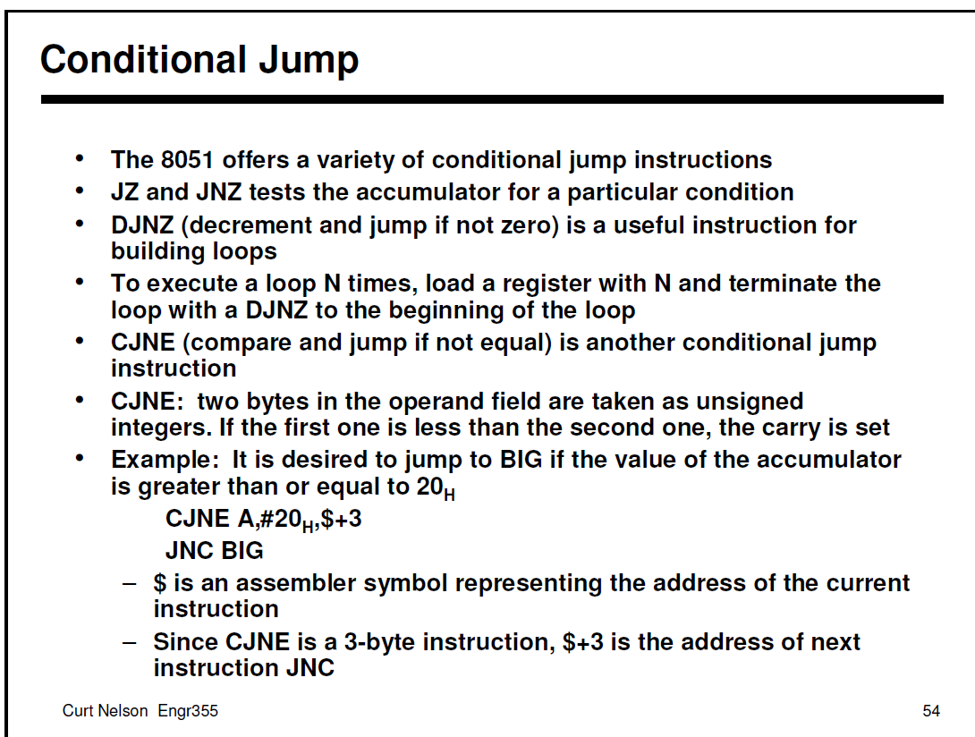

Slide 49
Unconditional Jump Instructions
SJMP (short jump): 2-byte instruction
1-byte relative address: -128 to +127

Slide 50
Call Instructions
LCALL (long call): 3-byte instruction
2-byte address
Target address within 64K-byte range
ACALL (absolute call): 2-byte instruction
11-bit address
Target address within 2K-byte range

Slide 51
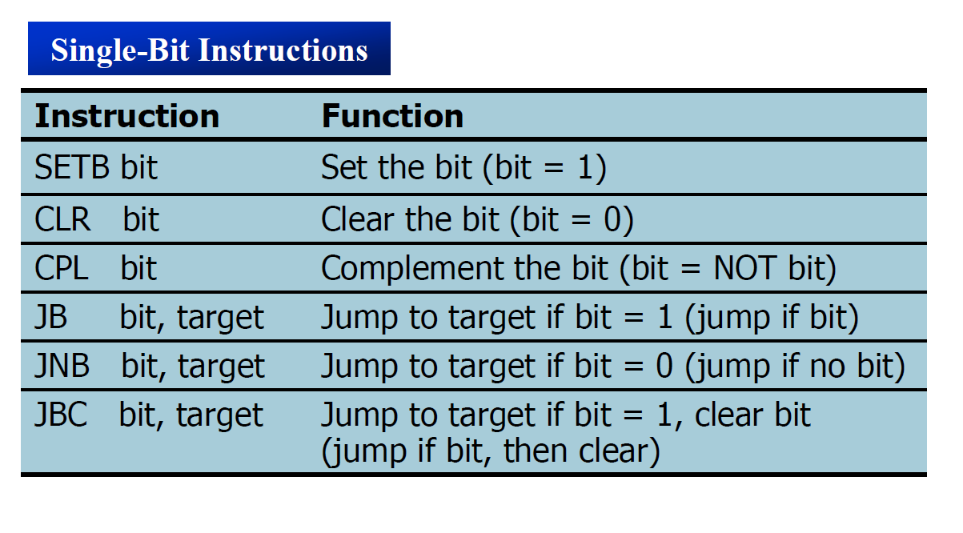
Single bit Instructions

Slide 52
8051 Interrupts

Slide 53
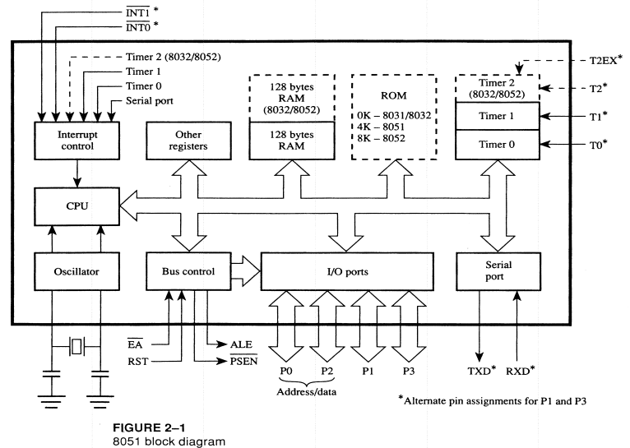

Slide 54
INTERRUPTS
An interrupt is an external or internal event that interrupts the microcontroller to inform it that a device needs its service
A single microcontroller can serve several devices by two ways:
Interrupt
Polling

Slide 55
Interrupt Vs Polling
Interrupts
Whenever any device needs its service, the device notifies the microcontroller by sending it an interrupt signal.
Upon receiving an interrupt signal, the microcontroller interrupts whatever it is doing and serves the device.
The program which is associated with the interrupt is called the interrupt service routine (ISR) or interrupt handler.
Polling
The microcontroller continuously monitors the status of a given device.
When the conditions met, it performs the service.
After that, it moves on to monitor the next device until every one is serviced.

Slide 56
Interrupt Vs Polling
The polling method is not efficient, since it wastes much of the microcontroller’s time by polling devices that do not need service.
The advantage of interrupts is that the microcontroller can serve many devices (not all at the same time).
Each devices can get the attention of the microcontroller based on the assigned priority.
For the polling method, it is not possible to assign priority since it checks all devices in a round-robin fashion.
The microcontroller can also ignore (mask) a device request for service in Interrupt.

Slide 57
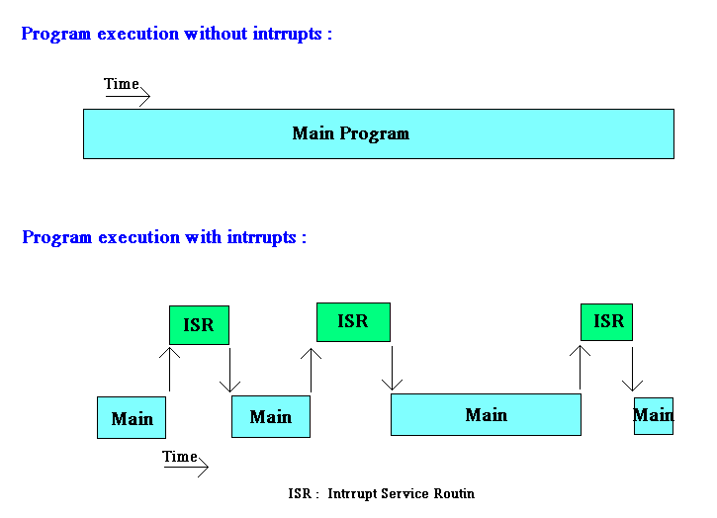

Slide 58
Steps in Executing an Interrupt
It finishes the instruction it is executing and saves the address of the next instruction (PC) on the stack.
It also saves the current status of all the interrupts internally (i.e: not on the stack).
It jumps to a fixed location in memory, called the interrupt vector table, that holds the address of the ISR.
The microcontroller gets the address of the ISR from the interrupt vector table and jumps to it.
It starts to execute the interrupt service subroutine until it reaches the last instruction of the subroutine which is RETI (return from interrupt).
Upon executing the RETI instruction, the microcontroller returns to the place where it was interrupted.

Slide 59
Six Interrupts in 8051
Six interrupts are allocated as follows:
Reset – power-up reset.
Two interrupts are set aside for the timers.
one for timer 0 and one for timer 1
Two interrupts are set aside for hardware external interrupts.
P3.2 and P3.3 are for the external hardware interrupts INT0 (or EX1), and INT1 (or EX2)
Serial communication has a single interrupt that belongs to both receive and transfer.

Slide 60
What events can trigger Interrupts?
We can configure the 8051 so that any of the following events will cause an interrupt:
Timer 0 Overflow.
Timer 1 Overflow.
Reception/Transmission of Serial Character.
External Event 0.
External Event 1.
We can configure the 8051 so that when Timer 0 Overflows or when a character is sent/received, the appropriate interrupt handler routines are called.

Slide 61
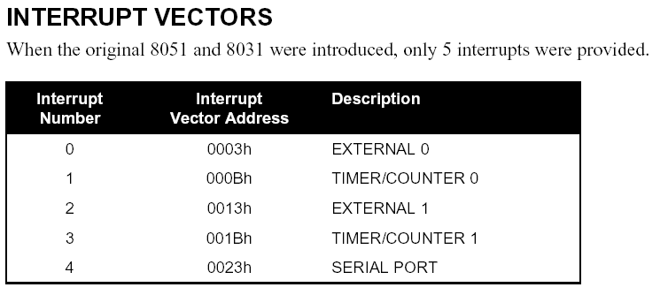
8051 Interrupt Vectors

Slide 62
8051 Interrupt related Registers
The various registers associated with the use of interrupts are:
TCON - Edge and Type bits for External Interrupts 0/1
SCON - RI and TI interrupt flags for RS232
IE - Enable interrupt sources
IP - Specify priority of interrupts

Slide 63
Enabling and Disabling an Interrupt
Upon reset, all interrupts are disabled (masked), meaning that none will be responded to by the microcontroller if they are activated.
The interrupts must be enabled by software in order for the microcontroller to respond to them.
There is a register called IE (interrupt enable) that is responsible for enabling (unmasking) and disabling (masking) the interrupts.

Slide 64
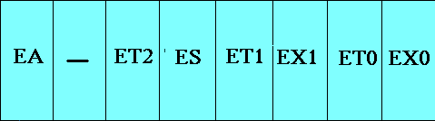
Interrupt Enable (IE) Register
--
EA : Global enable/disable.
--- : Reserved for additional interrupt hardware.
ES : Enable Serial port interrupt.
ET1 : Enable Timer 1 control bit.
EX1 : Enable External 1 interrupt.
ET0 : Enable Timer 0 control bit.
EX0 : Enable External 0 interrupt.
MOV IE,#08h or
SETB ET1

Slide 65
Enabling and Disabling an Interrupt
Example: Show the instructions to (a) enable the serial interrupt, timer 0 interrupt, and external hardware interrupt 1 and (b) disable (mask) the timer 0 interrupt, then (c) show how to disable all the interrupts with a single instruction.
Solution:
(a) MOV IE,#10010110B ;enable serial, timer 0, EX1
Another way to perform the same manipulation is:
SETB IE.7 ;EA=1, global enable
SETB IE.4 ;enable serial interrupt
SETB IE.1 ;enable Timer 0 interrupt
SETB IE.2 ;enable EX1
(b) CLR IE.1 ;mask (disable) timer 0 interrupt only
(c) CLR IE.7 ;disable all interrupts

Slide 66
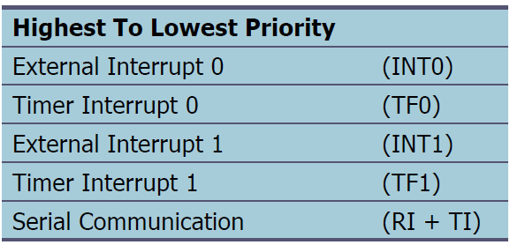
Interrupt Priority
When the 8051 is powered up, the priorities are assigned according to the following.
In reality, the priority scheme is nothing but an internal polling sequence in which the 8051 polls the interrupts in the sequence listed and responds accordingly.

Slide 67
Interrupt Priority
We can alter the sequence of interrupt priority by assigning a higher priority to any one of the interrupts by programming a register called IP (interrupt priority).
To give a higher priority to any of the interrupts, we make the corresponding bit in the IP register high.

Slide 68
Interrupt Priority (IP) Register
PS PT1 PX1 PT0 PX0
Reserved
Serial Port
INT 0 Pin
Timer 1 Pin
INT 1 Pin
Timer 0 Pin
Priority bit=1 assigns high priority
Priority bit=0 assigns low priority

Slide 69
Thank You

